Slide 1
Analysis of Global Superstore dataset using Power BI
By
Phani Pavani Srirangam

Slide 2
Dataset Used
Global Superstore Dataset

Slide 3
Introduction
This presentation will provide an overview of the key insights gained from analyzing the Global Superstore dataset. It will look at the highlights from this analysis, considering key trends as well as other interesting facts.

Slide 4
Technical Aspects of the project:
Cleaning and basic Analysis of Data Using Excel
Creating PowerBi dashboards to present the data

Slide 5
Description of dataset
Column name | Description
1. Order ID | A unique identifier for each sales order
2. Order Date | The date the order was placed
3. Ship Date | The date the order was shipped
4. Ship Mode | The method of shipping for the order
5. Customer ID | A unique identifier for each customer
6. Customer Name | The name of the customer who placed the order
7. Segment | The market segment the customer belongs to (Corporate, Home Office, or Consumer)
8. Country | The country where the customer is located
9. City | The city where the customer is located
10. State | The state where the customer is located
11. Postal Code | The postal code where the customer is located
12. Region | The region where the customer is located
13. Product ID | A unique identifier for each product
14. Category | The category of the product (Furniture, Office Supplies, or Technology)
15. Sub-Category | The sub-category of the product
16. Product Name | The name of the product
17. Sales | The amount of sales for each product
18. Quantity | The quantity of each product sold
19. Discount | The discount applied to each product
20. Profit | The profit generated from each sale

Slide 6
Problem statement derived from dataset
What is the total sales by region
Profitability by Category
Product performance Tracking
Insights on Seaosonal Shifts

Slide 7
Total sales by Region
Sum of sales
Row Labels | Sum of Sales
Africa | 783773.211
Canada | 66928.17
Caribbean | 324280.861
Central | 2822302.52
Central Asia | 752826.567
East | 678781.24
EMEA | 806161.311
North | 1248165.603
North Asia | 848309.781
Oceania | 1100184.612
South | 1600907.041
Southeast Asia | 884423.169
West | 725457.8245
Grand Total | 12642501.91

Slide 8
Profit by Category
Category | Sales | Profit
Technology | 4744557.498 | 663778.7332
Furniture | 4110874.186 | 285204.7238
Office Supplies | 3787070.225 | 518473.8343

Slide 9
Customer Count by Location
Row Labels | Count of Customer Name
Africa | 4587
Canada | 384
Caribbean | 1690
Central | 11117
Central Asia | 2048
East | 2848
EMEA | 5029
North | 4785
North Asia | 2338
Oceania | 3487
South | 6645
Southeast Asia | 3129
West | 3203
Grand Total | 51290

Slide 10
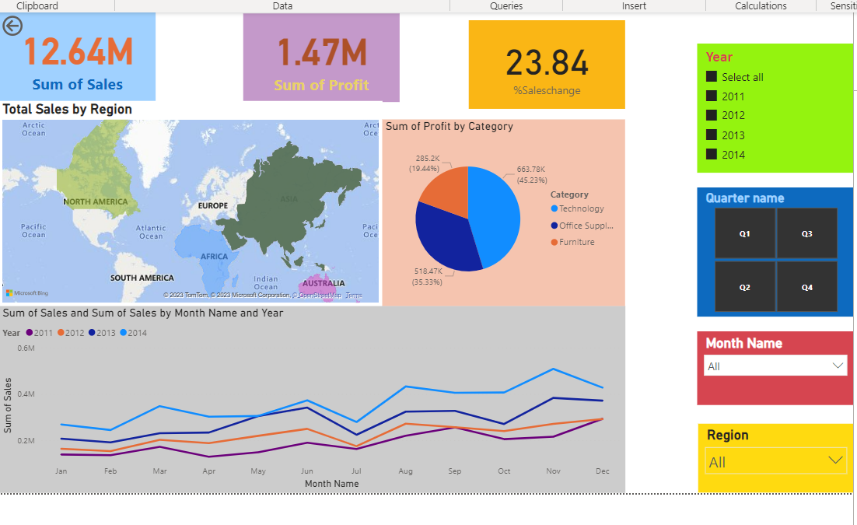
Power BI Dashboard

Slide 11
Insights
The majority of sales come from the Central region
There is a clear seasonal variation in sales, with the peak months being November and December.
The most profitable category is Technology, followed by and office supplies and Furniture.
By tracking these seasonal shifts, we can make sure we have the right products in stock at the right time.

Slide 12
Conclusion
These insights can help inform strategic decisions on where to focus resources and marketing efforts.

